Slide 1
Machine Learning Model

Slide 2
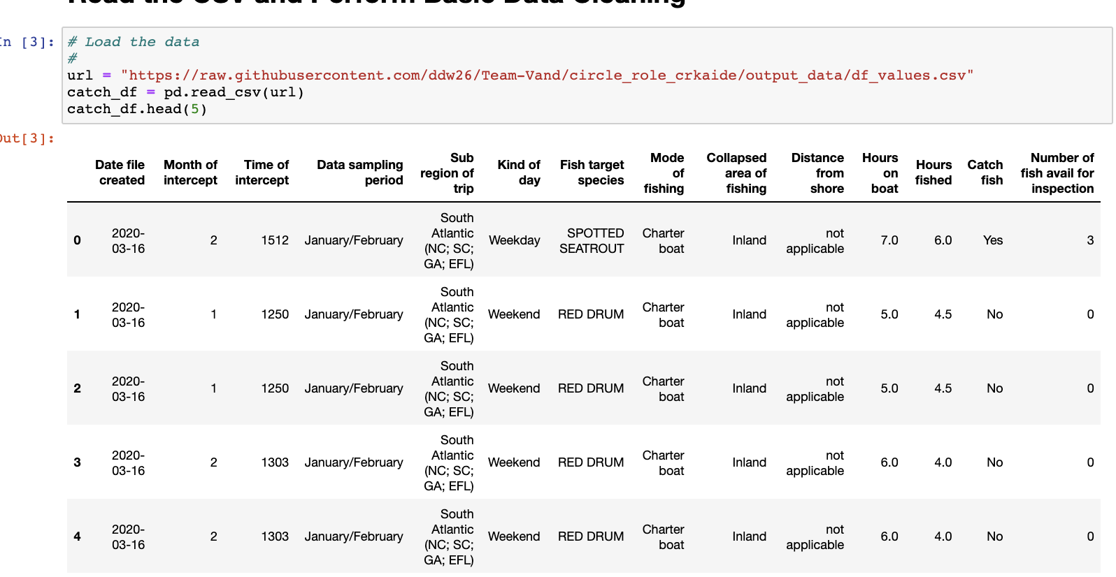
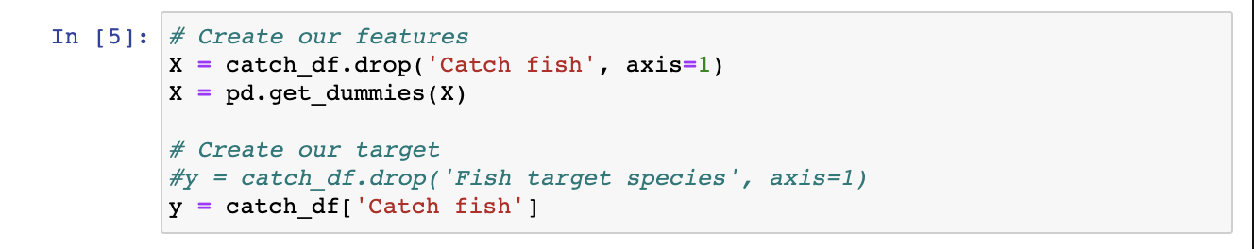
Defining our scope
Ingest source data
Refine fields to allow for a seamless machine learning experience
Identify our target question - “How likely will a fishing trip catch fish?”

Slide 3
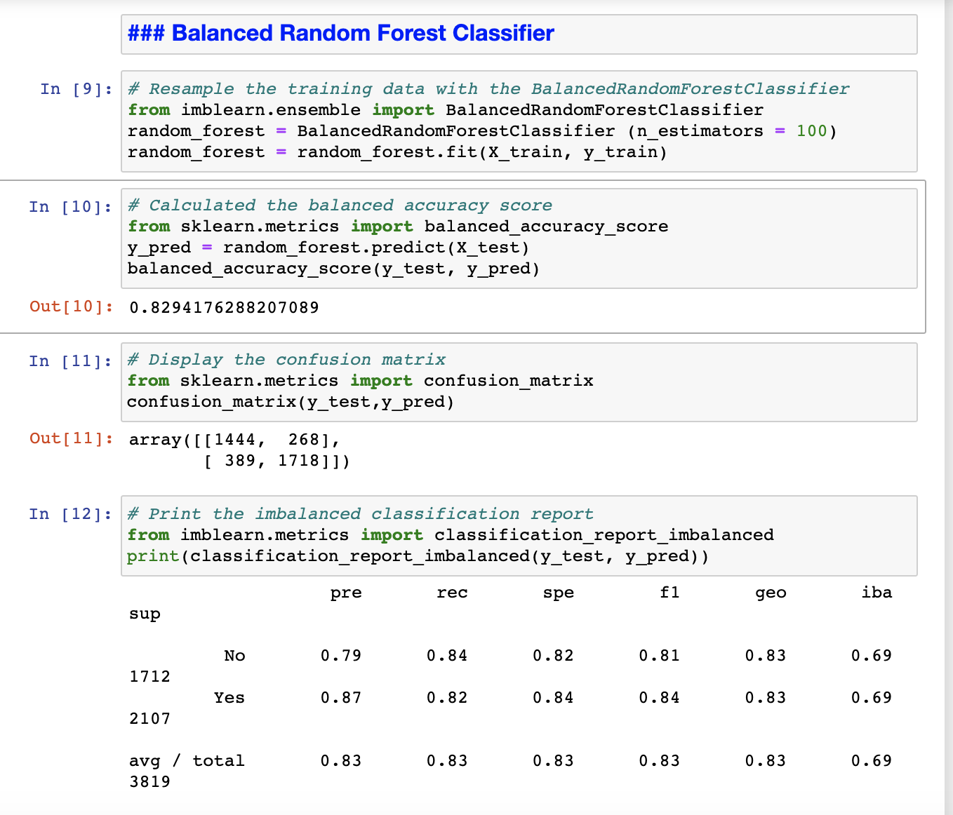
Model Selection & Results
Initial models tested: neural networks, random forests and Easy Ensemble
Give our data set and objective of predicting the likelihood of successfully catching fish, we decided to use Balanced Random Forest.

Slide 4
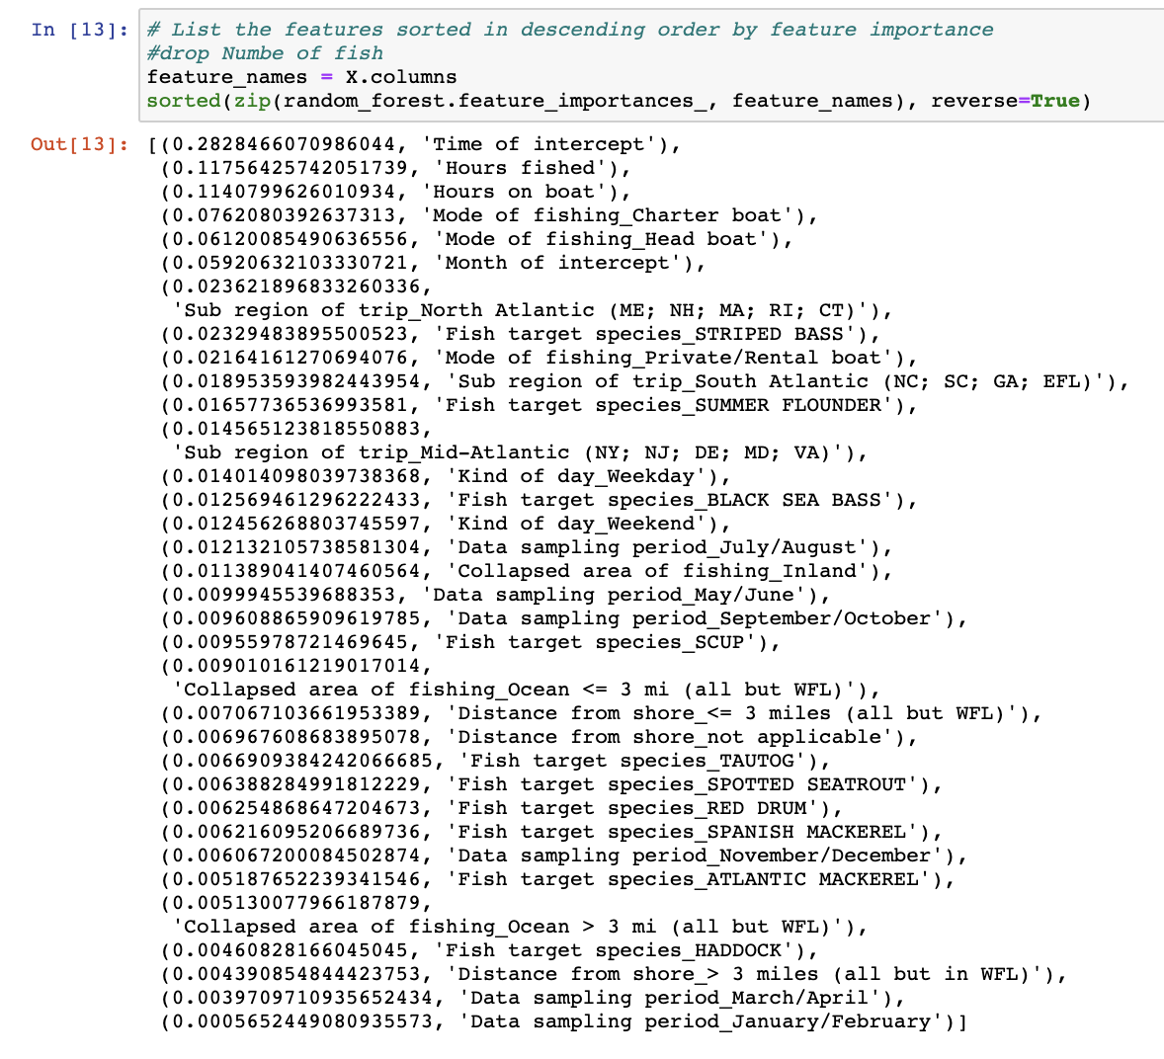
Model Selection & Results Continued
With this model, we were able to achieve an 83 % accuracy rate.
Initial challenge: identifying features skewing our model results
Hours spent on a given fishing expedition has the greatest impact on the models predictability of success

